Slide 1
COMPUTER NETWORKS 2022 Fall
- Chapter 1.1: Introduction
王昊翔
WANG Haoxiang
hxwang@scut.edu.cn
School of Computer Science & Engineering
国家双语教学试点项目 广东省精品课

Slide 2
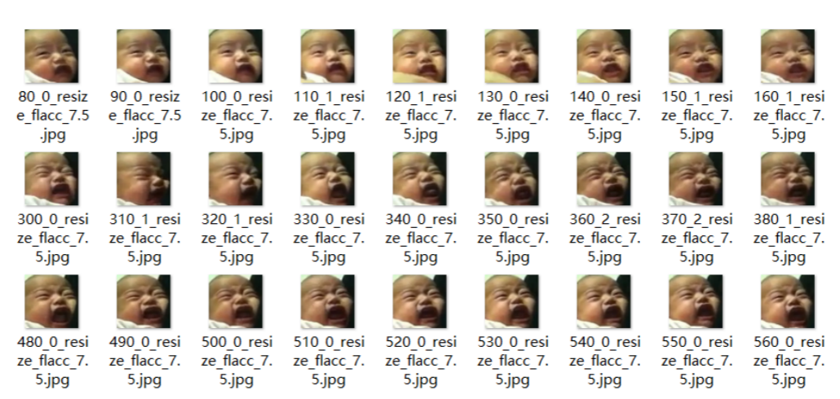
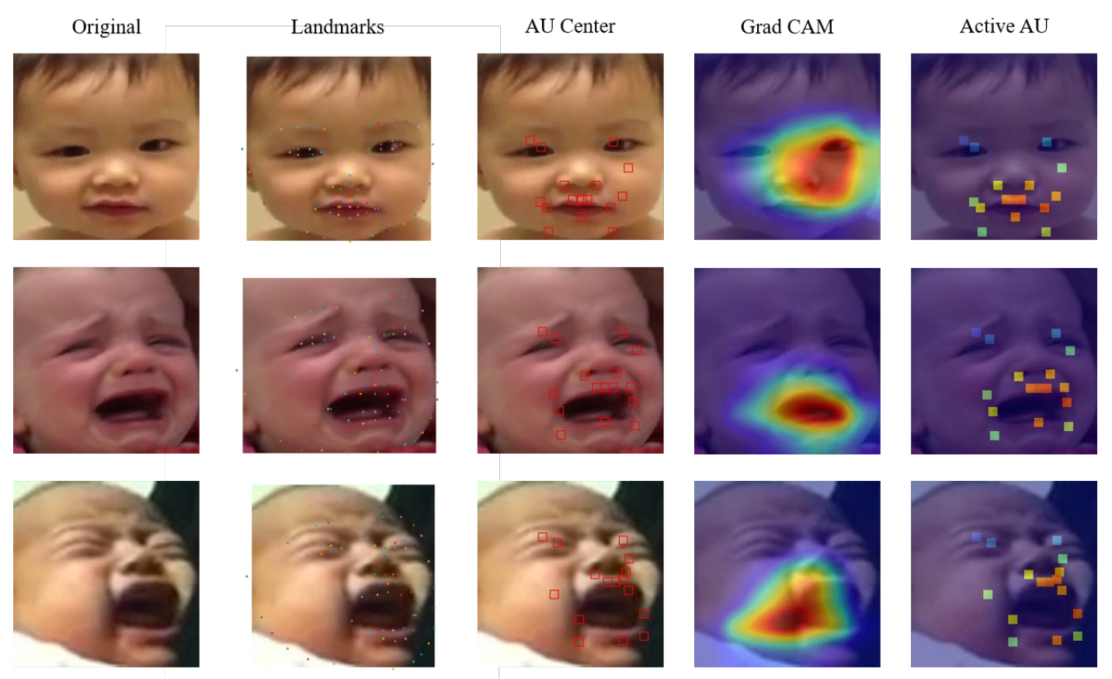
About me
Haoxiang WANG 王昊翔
Research
Deep learning - Affective Computing: Facial emotion - Speech emotion - EEG - etc.
Big data analysis - Recommender Systems
Neonatal Pain Recognition
Teaching
Computer networks
Intro 2 CS
etc.

Slide 3
Syllabus 课程大纲
Course Title | Computer Networks
Course Category | Disciplinary Basic Course
Course Nature | Compulsory Course
Class Hours | 64 teaching sessions, including 16 lab sessions
Credits | 3.5
Semester | The fifth semester
Institute | School of Computer Science and Engineering
Program Oriented | Computer science and technology, network engineering, information security
Teaching Language | English
Prerequisites | Foundations of Computer Science, Computer Organization and Architecture

Slide 4
Roadmap-Intro
INTRO.
Defs: networks, Computer networks
History
Classification
Layered Struction: TCP/IP and OSI
Protocol v.s. Service
App L
Transport L
Network L
MAC subL
DLL
Physical L

Slide 5
Roadmap-Physical Layer
Theorical basis: 3 theorems
Tramsmission medium: wire and wireless
Tel systems: 3 main components
Mobile tel: from 1G to 5G
CDMA: working principle
etc. satellite comm.
App L
Transport L
Network L
MAC subL
DLL
Physical L

Slide 6
Roadmap- DLL
Error process: Detection & Correction
6 elementary DLL protocols
Piggybacking, sliding windows
Example protocols
App L
Transport L
Network L
MAC subL
DLL
Physical L

Slide 7
Roadmap-MAC Sub-layer
Multiple access protocols: static & dynamic
CSMA family
Ethernet & IEEE802.3
Devices
App L
Transport L
Network L
MAC subL
DLL
Physical L

Slide 8
Roadmap-Network Layer
Network Layer
Routing: algorithms - static, dynamic-DV, LS
Routed: IP protocols - v4, v6
IP, Subnet, CIDR, NAT, etc.
App L
Transport L
Network L
MAC subL
DLL
Physical L

Slide 9
Roadmap-Trans & App Layers
Transport Layer:
TCP, UDP
Application Layer
DNS
App L
Transport L
Network L
MAC subL
DLL
Physical L

Slide 10

Very IMPORTANT!!!
Marking scheme （评分标准）
Paticipation(30%)
Lab(20%)
Exam(50%)

Slide 11
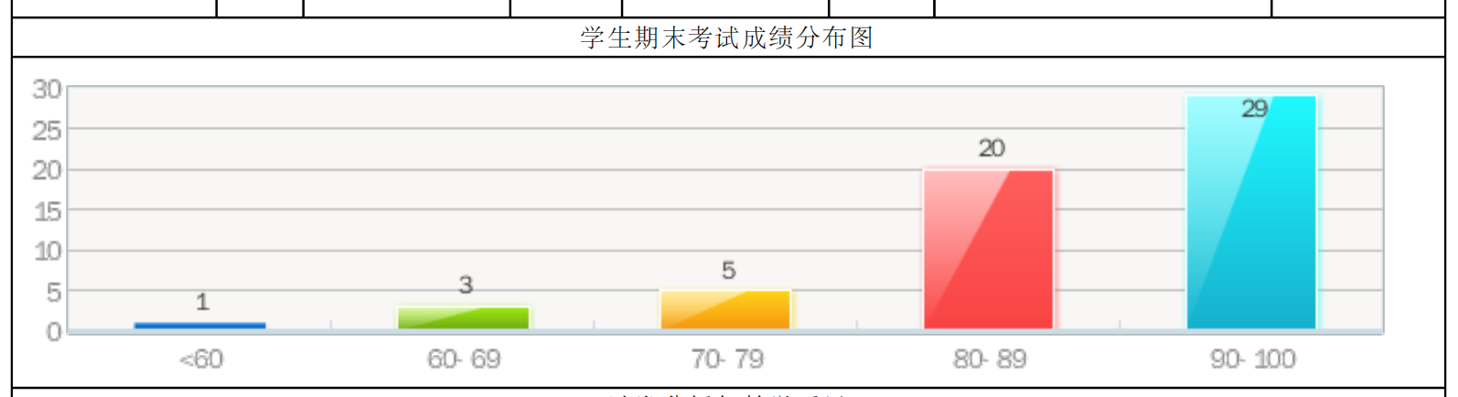
Very IMPORTANT!!! - marking scheme
Paticipation(30%)
Attendance 10（inc. labs）
MOOC/SPOC 10
Presentation, Q&A 10
Lab(20%)
Demo 10
Report 10
Exam(50%)
50/100

Slide 12
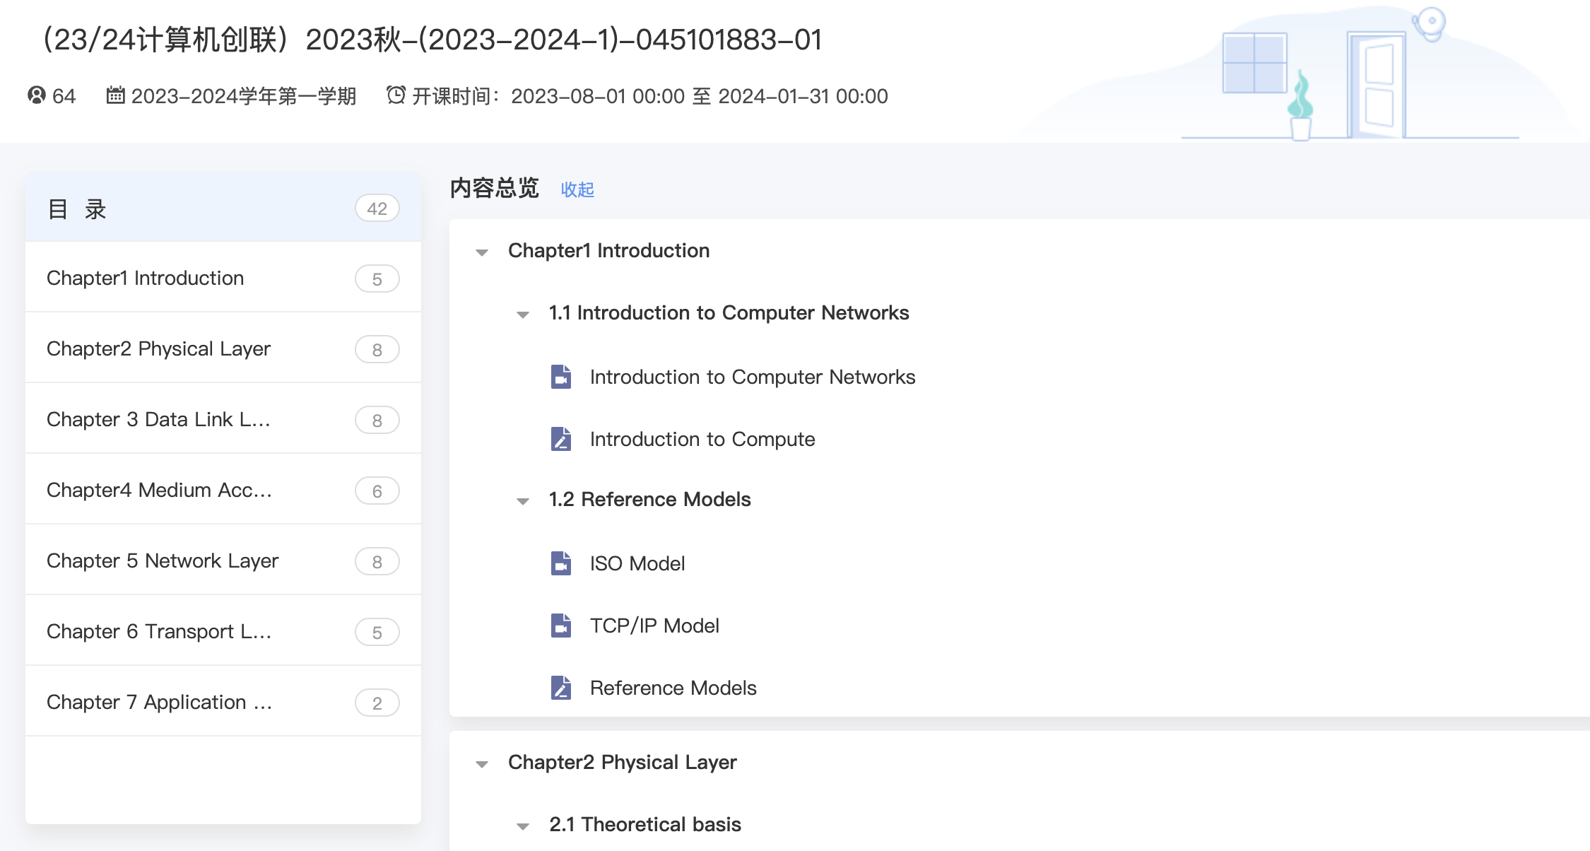
SPOC
SCUT Yuketang: 雨课堂
https://scut.yuketang.cn

Slide 13
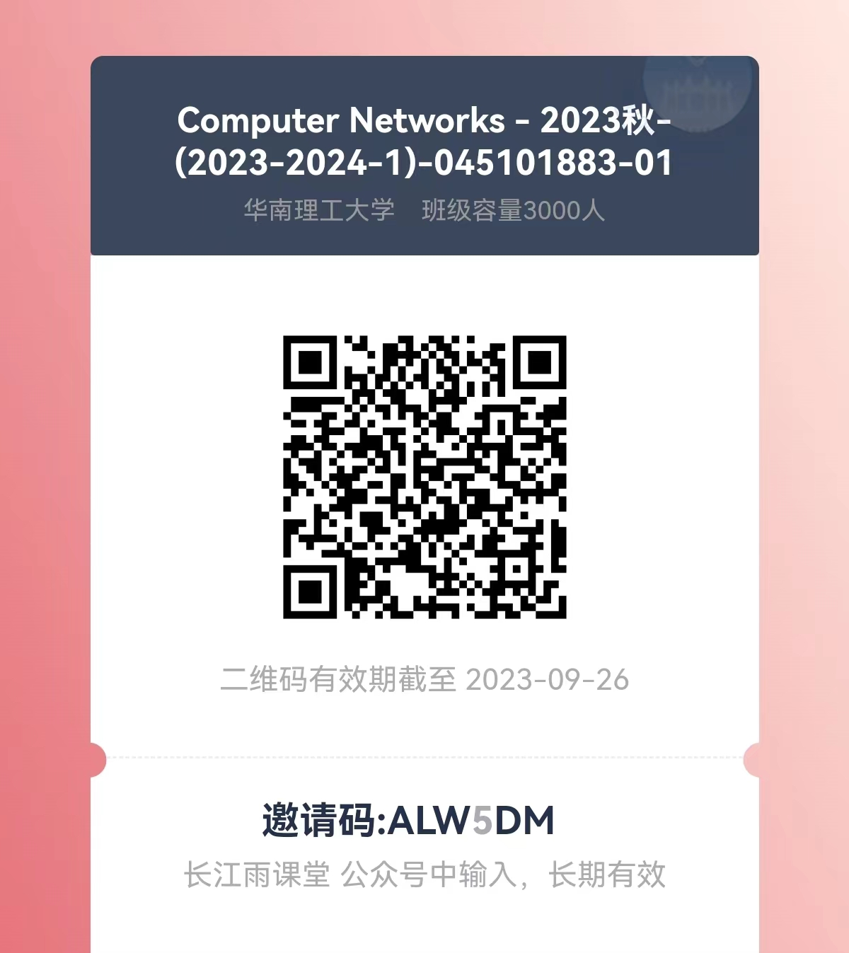
SPOC for oversea student

Slide 14
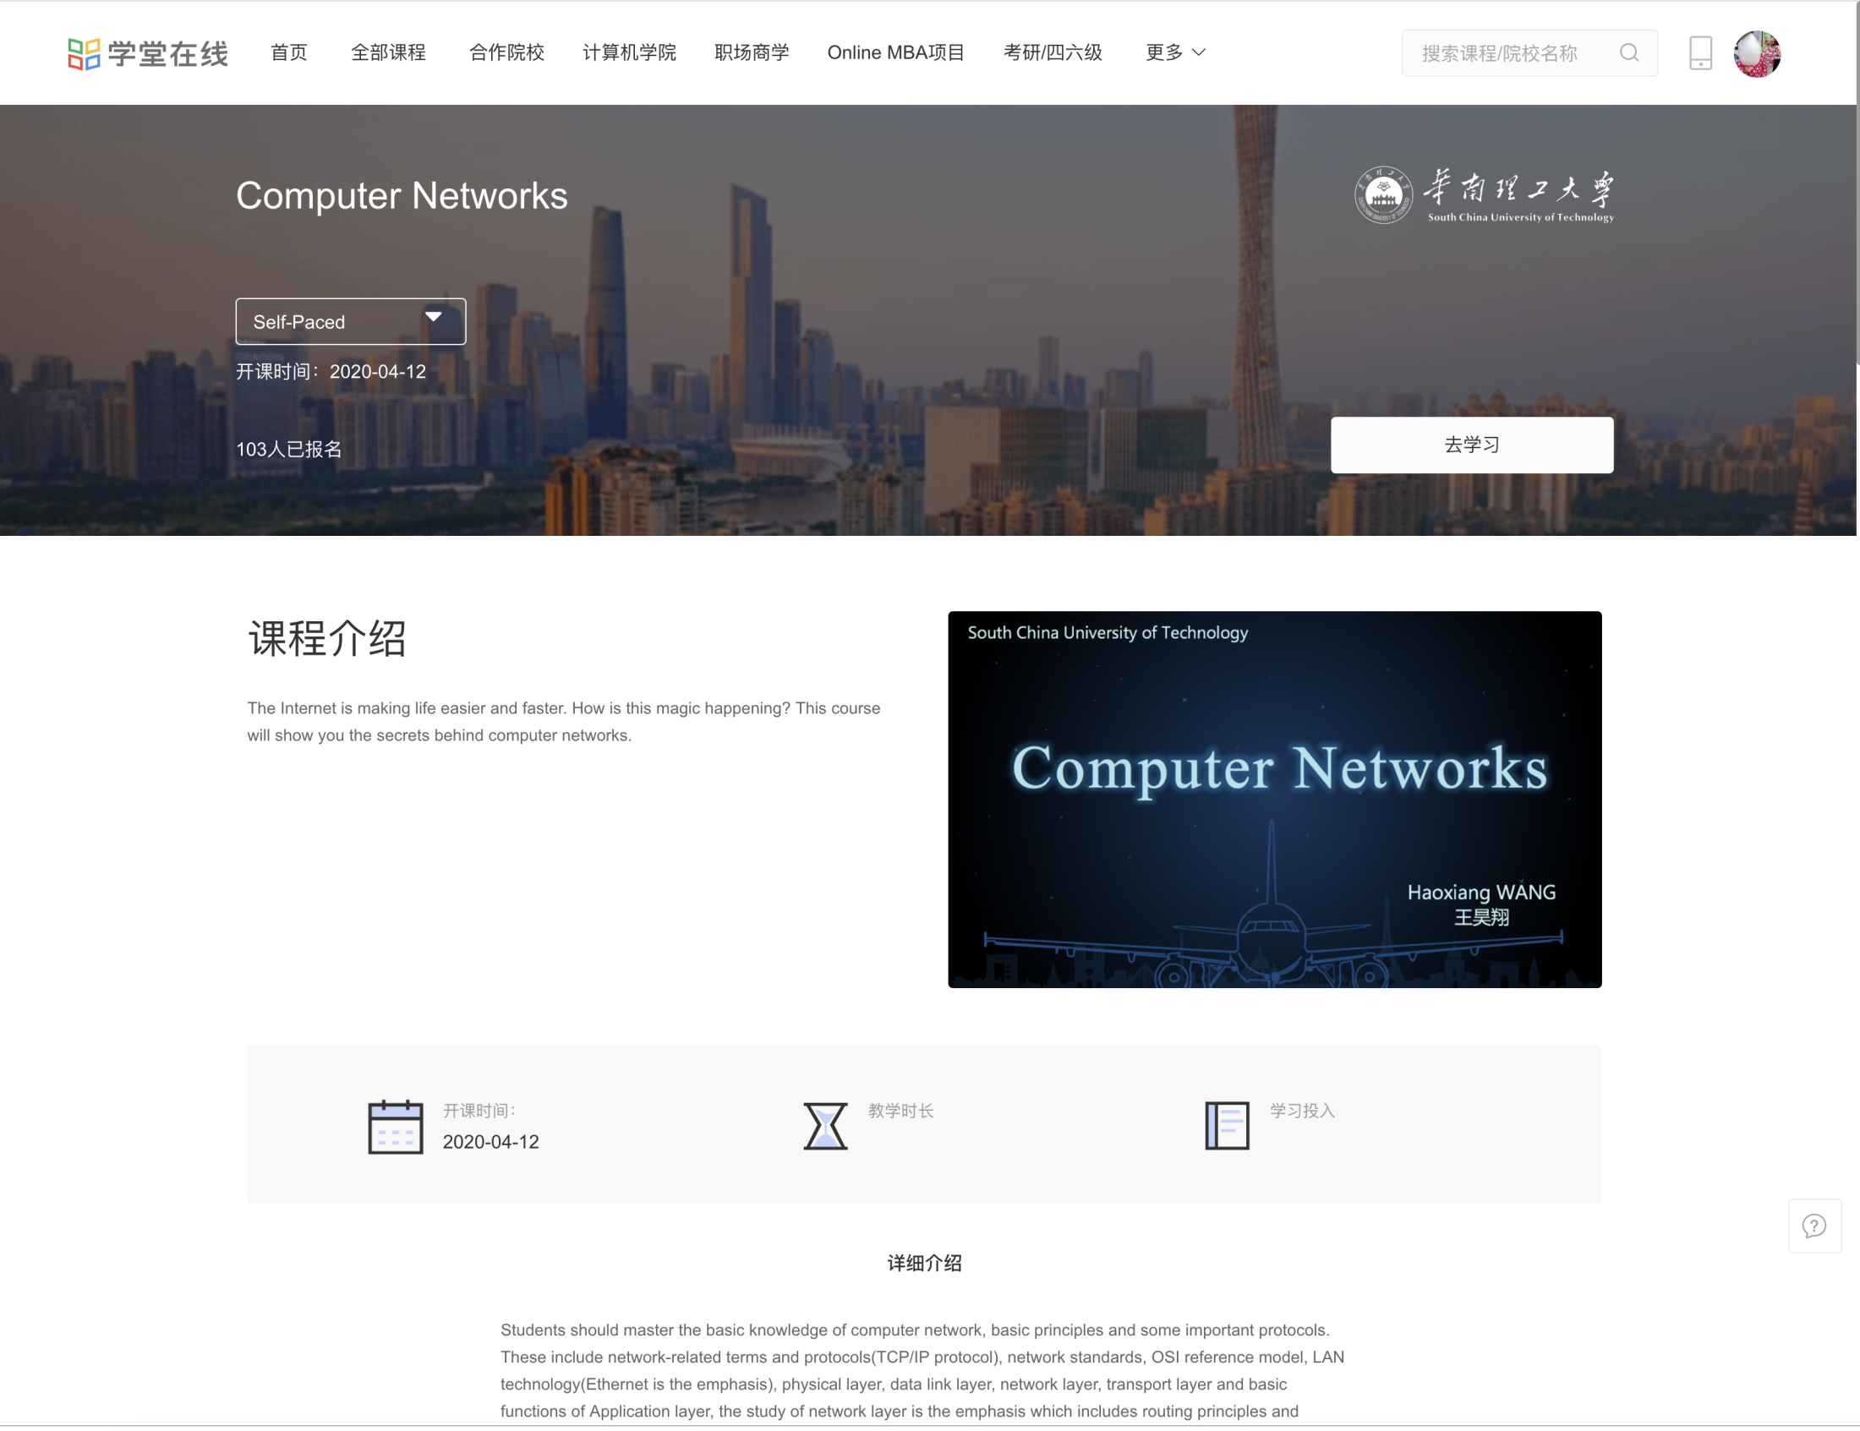
MOOC (If SPOC doesn’t work)
For international students: （ifyou have problem of using Yuketang）
https://next.xuetangx.com/course/scut08091001002intl/3994979

Slide 15
Oversea/Home students
All course materials are exactly the same!
same videos
same slides
same quizzes
xuetangx.com Self-paced/public access
https://scut.yuketang.cn
Syn with offline class
Private access. I can monitor you
Chinese interface
Working on creating accounts for oversea stu

Slide 16
Presentations, Q&A
64？ home students
4-6？students / group
13 + 3 topics
～15-20 mins talk, ~5 mins discussion
Prepare discussion questions for your audience.
Q&A (Bonus for raising questions?)
Kick off in week 2
Keep improving
Need your understanding, cooperation or even tolerance

Slide 17
Presentations
No. | Ch. | Topics
01 | 2 | Wires for data transmission
02 | 2 | Wireless communication
03 | 2 | Mobile telephone system
04 | 3 | Error correction & Hamming encoding
05 | 3 | A brief of other Error Correction Codes
06 | 4 | Ethernet and IEEE802.3
07 | 5 | OSPF protocol
08 | 5 | IPv6 and comparisons with IPv4
09 | 5 | ICMP: Internet Control Message Protocol
10 | 6 | Intro to TCP - working principles and examples
11 | 6 | Intro to UDP, and comparisons with TCP
12 | 7 | Belief of DNS: Domain name system
13 | 7 | DNS Hijacking

Slide 18
Presentation
No. | Ch. | Topics
14 | L1 | Network traffic analysis(wireshark)
15 | L2 | Basic router config
16 | L3 | Networking
About lab?

Slide 19


CN and CN（课程思政）
1986/08/25 11:11am first email
1994 CERNET national-wide TCP/IP network
1998 CERNET IPv6 testbed
2003 CNGI project
2008 world first Live on IPv6 network
Tsinghua, IPv6 research, on the cutting edge
SAVI、SAVA
IPv4OverIPv6
Address translation
SCUT
IPv9?

Slide 20

Before we kick off…
Rules for this module:
FREEDOM
Brave heart
BUT

Slide 21
Reference
Andrew S. Tanenbaum , 《 Computer Networks 》
谢希仁等著,《计算机网络》
Vito Amato（美）, 《思科网络技术学院教程》
James F. Kurose, Keith W. Ross, 《Computer Networking: A Top-Down Approach Featuring the Internet》
Larry L. Peterson, Bruce S. Davie, 《Computer Networks: A Systems Approach》
Just for recommendation… :-P

Slide 22
Treasure
Collaboration of Profs across the nation.
Might be the best CN self-learning slides in China or even on the Earth.
https://cloud.tsinghua.edu.cn/d/4b12b05d30dc435688c3/

Slide 23
Session 1
What is the Networks
Classify Computer Networks

Slide 24
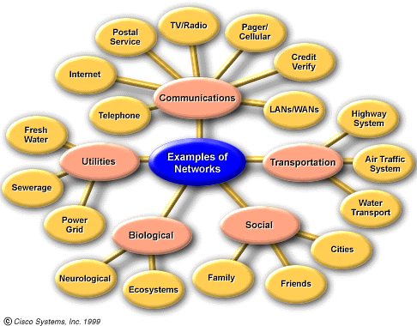
What is the networks in general ?

Slide 25
What is “Computer Networks”
Computer: CPU + MEM + Peripherals.
Basic Concept of Computer Networks:
A collection of autonomous computers interconnected.
Interconnected: Be able to exchange information
Autonomous: Be able to handle independently
Host/Computer toward Distributed System:
Multi－Tasks，Multi-Users, Multi-Cores…
In modern and broad sense of CN:
Network is the Computer (Complicated & Ind.)

Slide 26
Network History
An example work from previous students
Pros & Cons

Slide 27
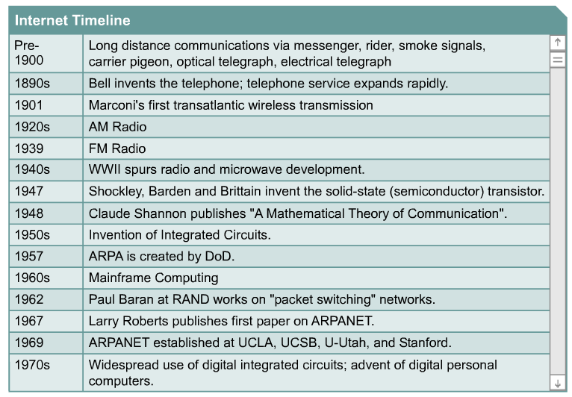
Network History-Communications

Slide 28
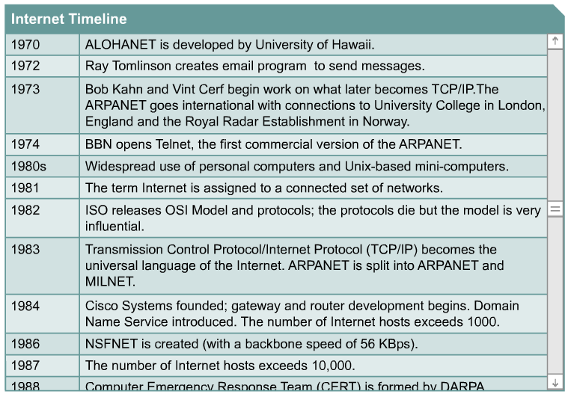
Network History-Computers

Slide 29
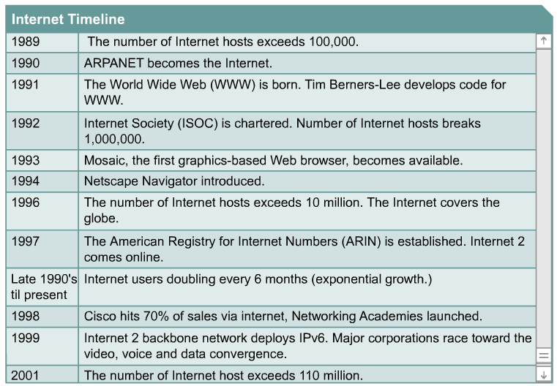
Network History-Internet

Slide 30
Communication networks ?
Digital/Data Communication
Computer Networks
Data Networks
Internet: NGI,NGN
Sensor Networks

Slide 31
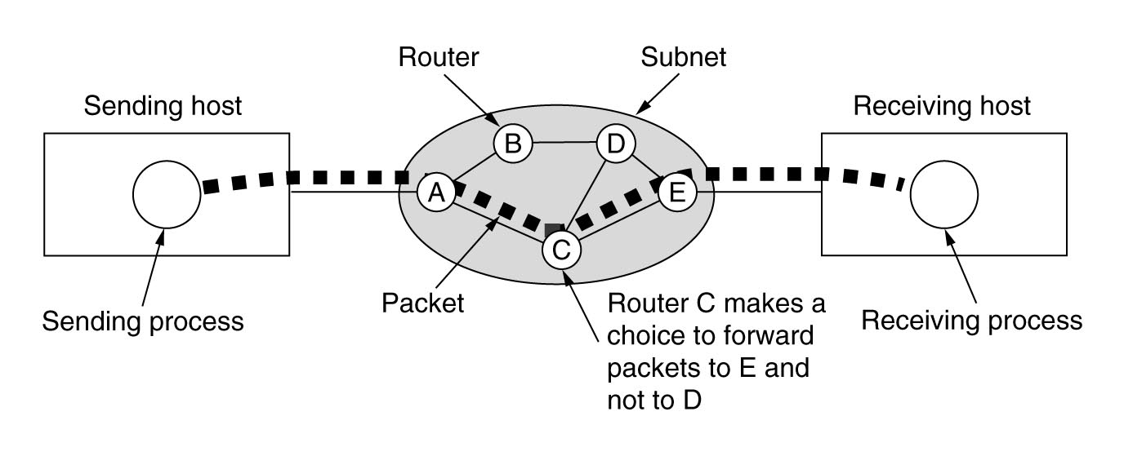
Computer networks:
A stream of packets from sender to receiver

Slide 32
So many different:
Variety of Size
Variety of Topology
Variety of Speed/Bandwidth
Variety of Transmission Medium
Variety of Communication Tech.
Variety of Communication mode/BD
Variety of Services
Variety of Applicants/Usage
研究方法：Think about Library ?

Slide 33
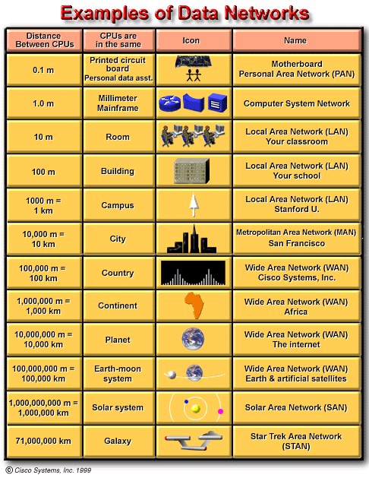
Networks Classify in Size

Slide 34
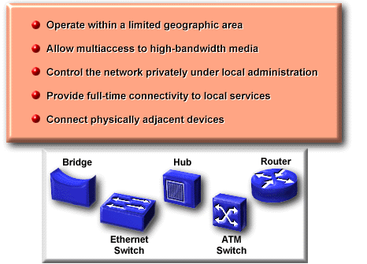
Local Area Networks
Widely used to connect pc and workstations in company offices and factories to share resources (e.g., printers) and exchange information

Slide 35
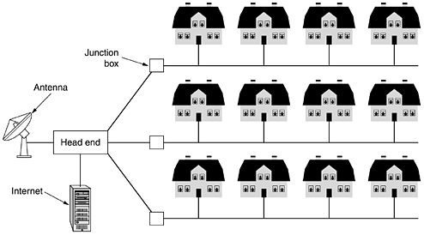
Local/Metropolitan Area Networks

Slide 36
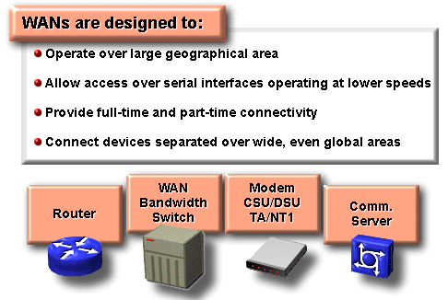
Wide Area Networks
Some common WAN technologies are:
•Frame-Relay/ATM (Asynchronous Transfer Mode) : 64Kbps – 155Mbps
•E/T-Carrier Series (in U.S.:T1, T3, etc.) : 1.5Mbps/2Mbps – 155Mbps
•SONET/SONET (Synchronous Optical Network) : 155Mbps- 10G+

Slide 37
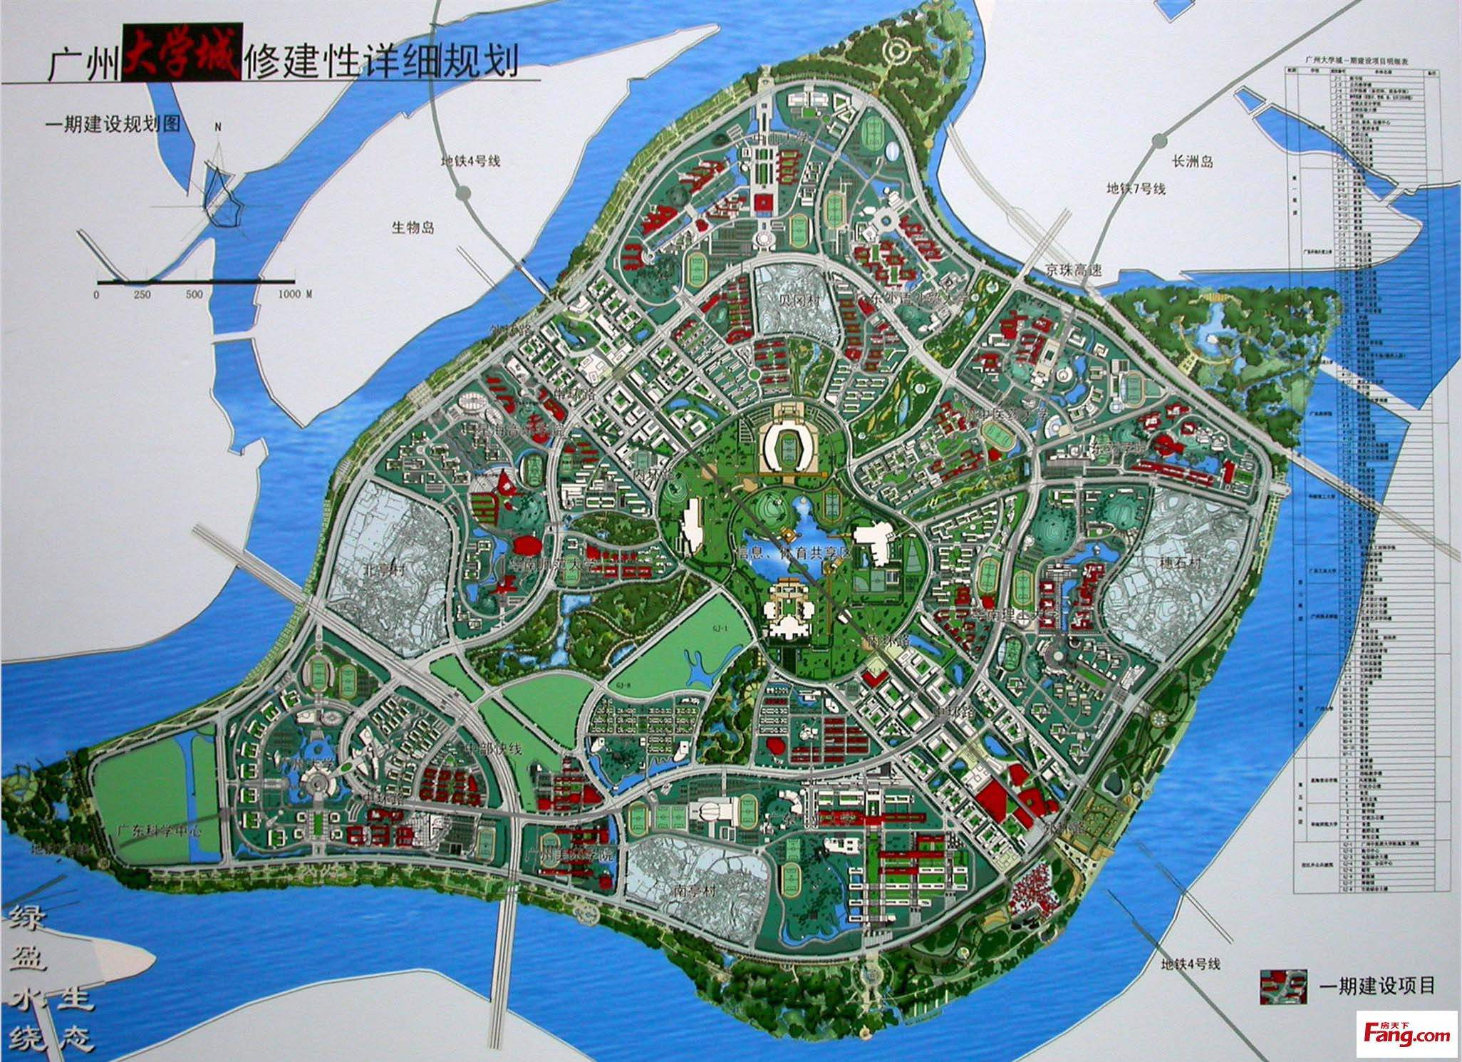
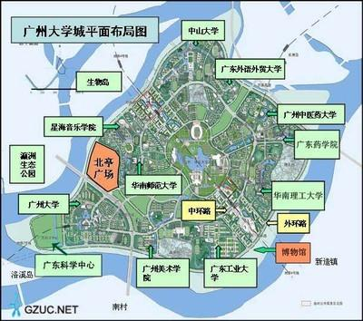
Discussion(1)
Networks on this island (High Edu Mega City)
LAN or MAN

Slide 38
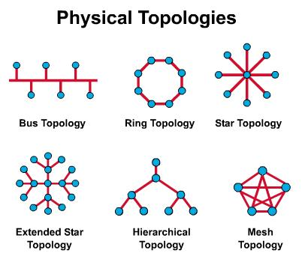
Network Topology:
Layout of inter-connections (信道的分布方式)

Slide 39
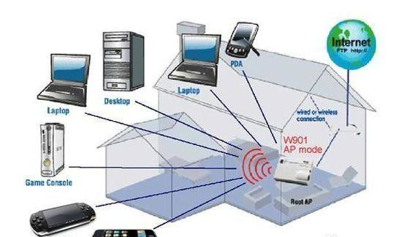
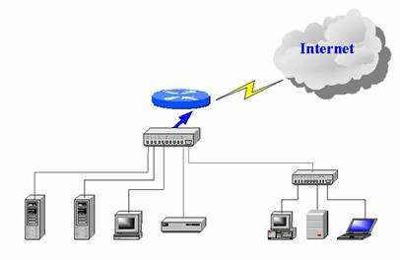
Discussion(2)
LAN in a house

Slide 40
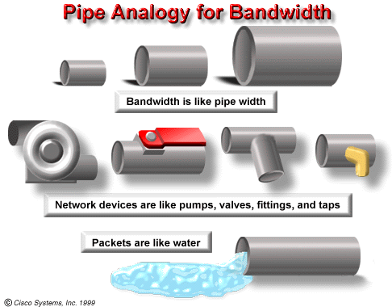
Network Bandwidth-I:

Slide 41
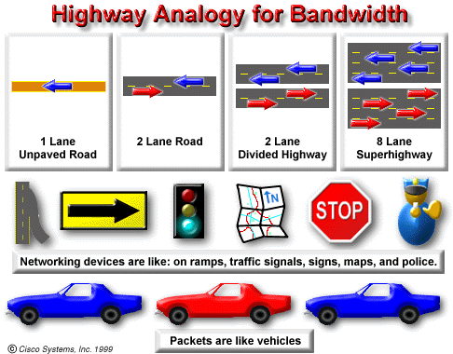
Highway Analogy for Bandwidth:

Slide 42
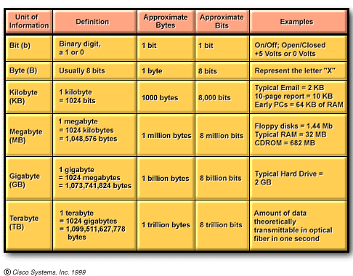
Measurement-I:

Slide 43
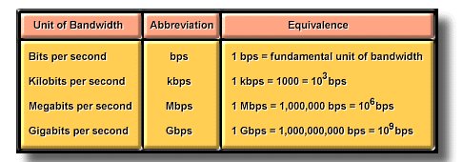
Measurement-II:
The fundamental unit of bandwidth:
A unit of information (lets say the bit) per unit of time (lets say a second) is the bit per second,

Slide 44
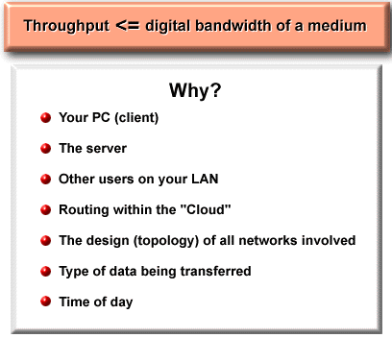
Throughput:
Usually refers to actually measured bandwidth, at a specific time of day.

Slide 45
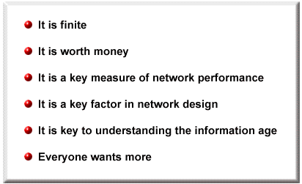
The Importance of Bandwidth:

Slide 46
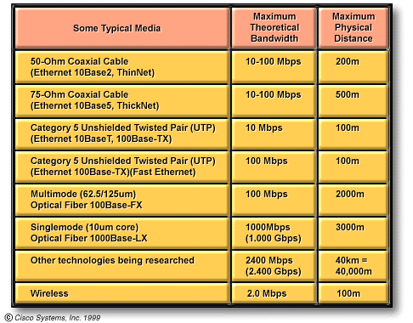
Transmission medium:
No matter how you send your messages, no matter which physical medium you use, bandwidth is limited. This is due both to the laws of physics and to current technological advances.

Slide 47
Communication Technology:
For twisted-pair cable:
Modem:
300bps,1200bps,9600bps,28kbps,33kbps,56kbps
XDSL:
128Kbps, 1Mbps,4Mbps,6Mbps
Ethernet:
10Mbps, 100Mbps, 1000Mbps…
For Fiber:
Ethernet: 10/100Mbps, 1/10Gbps +
SDH: 155Mbps, 2.5Gbps, 1.6Tbps +

Slide 48
Communication Mode:
Point-to-Point
Multicast
Broadcast

Slide 49
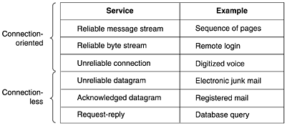
Type of Services

Slide 50
So many different:
Variety of Size (Location)
Variety of Topology
Variety of Speed/Bandwidth
Variety of Transmission Medium
Variety of Communication Tech.
Variety of Communication mode/BD
Variety of Services
Variety of Applicants/Usage
Think about telephone network ?

Slide 51
Many thanks:
Cisco Academy
Coursework: yuketang videos and questions

